Slide 1



KUVEMPU UNIVERSITY
Department of of P.G. Studies & Research in Applied Botany
Project Presentation On:
Preliminary phytochemical screening and in vitro antibacterial activity of stem extract of cissus quadrangularis L
Presented by:
Kuvempu university, Shankaraghatta.
Project Guide:
Dr. REENA ROY
Lecturer
Department of Applied Botany,
Kuvempu University, Shankaraghatta.

Slide 2
Contents
Introduction
Medicinal properties
Objectives
Materials and methods
Results and discussion
Conclusion
Reference

Slide 3
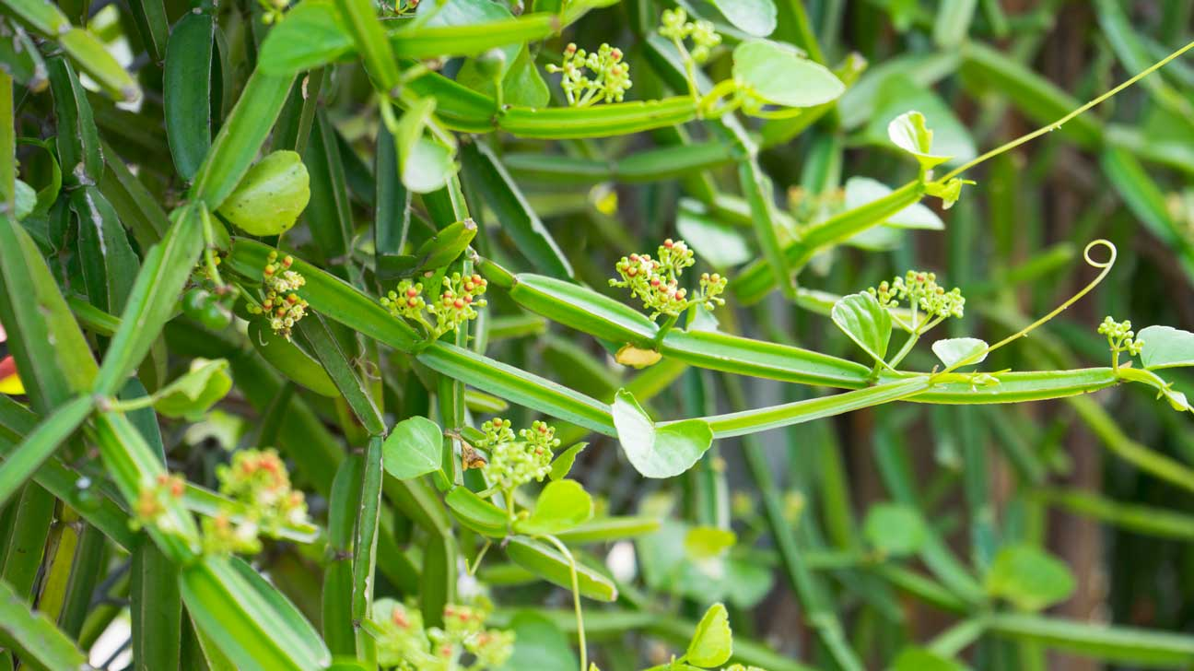
Introduction
The plant kingdom has been the best source of remedies for curing a verity of disease and pain.
In the present era of drug development and in discovery of newer drug, molecules of many plant products are evaluated on the basis of their traditional uses.
Cissus quadrangularis (Linn) is a succulent perennial climber, scattered all over India is a traditional medicinal plant which shows promising results in joint and bone health.
Cissus quadrangularis has quadrangular stems, small leaves and also roots that all possess medicinal properties as revealed by the surveys and trials conducted by ethno-botanists and traditional herbal healers especially for the treatment of bone fractures and swelling.
The stem is bitter in taste and commonly used as the oral and topical applications in bone fractures, complaints of the back and spine, asthma, heat burns, wounds and insect bites.
Fig.1. Cissus quadrangularis
Kingdom : Plantae
Division : Magnoliophyta
Class : Magnoliopsida
Order : Vitales
Family : Vitaceae
Genus : Cissus
Species : quadrangularis Linn.

Slide 4

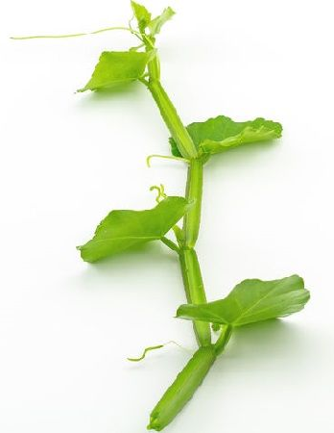


Medicinal Properties
Boosts immune system
Very good for improving bone health
Rich in Vitamin C and Vitamin E
Provides relief from respiratory disorders
Antibacterial activity
Antioxidant activity
Aids in quick healing of wounds
Diabetes treatment

Slide 5
Objectives
1
To extract secondary metabolites from Cissus quadrangularis stem using low and medium polar solvents.
2
To conduct the preliminary phytochemical analysis from the crude extract of C. quadrangularis.
3
To test the antibacterial activity of ethanolic crude extract.

Slide 6
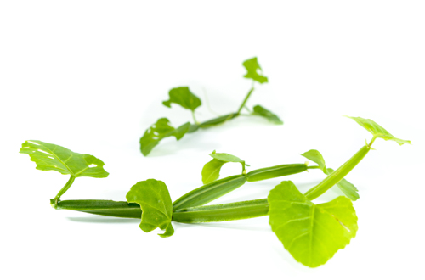

Materials and methods
Collection of Plant Source
Isolation and Extraction of Phytochemical from C. quadrangularis extract
Phytochemical Analysis Of Crude Extract
Antibacterial Activity of C. quadrangularis Extract.

Slide 7
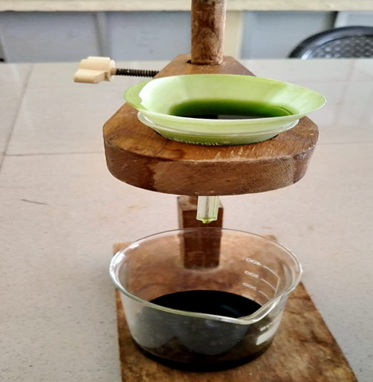
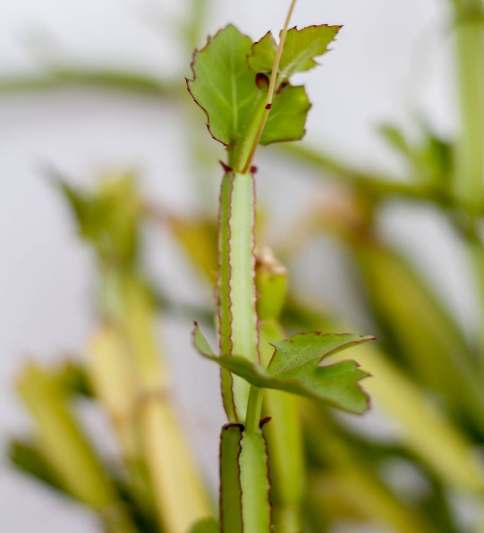
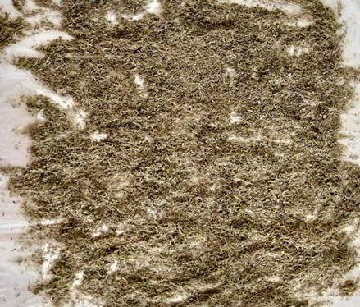
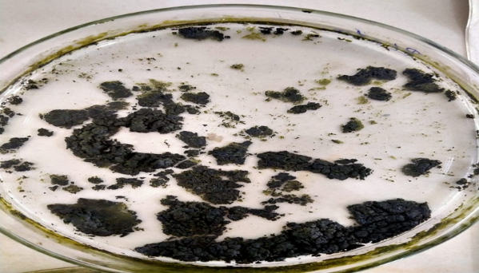
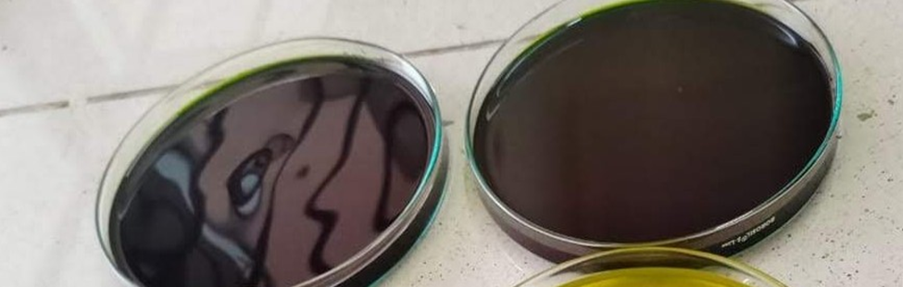
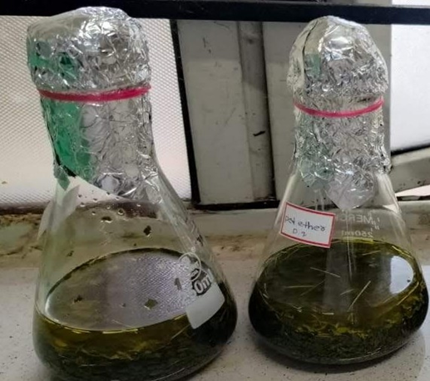
Cont.,
Isolation and Extraction of Phytochemical from
C. quadrangularis extract

Slide 8
Cont.,
C. quadrangularis extract
Phytochemical screening
Antibacterial Activity of C. quadrangularis Extract ( Zhang et al., 2009).
Test for Alkaloids
Mayers test
Wagner’s test
Test for Steroids
Salkowishki test
Test for Saponins
Foam test
Test for Tannins
Ferric Chloride test
Gelatine test
Test for Glycosides
Kellar killani test
Legal test
Test for Terpenoides
Salkowishki test
Test for Flavonoids
Ferric Chloride test
Shinoda test
Alkaline reagent test
Lead acetate test
Test for Phenols
Ferric Chloride test
Ellagic acid test
Preparation of culture media
Inoculation of bacterial cell suspension
Addition of C. quadrangularis extract
Measurement of Zone of Inhibition

Slide 9
Results and Discussion
Table.1. Phytochemical screening of stem of C. quadrangularis extracted in various solvents.
Sl. No | Secondary metabolites | Chemical test | Plant extract
 |  |  | Petroleum ether | Chloroform | Ethanol
1. | Alkaloids | Dragendorffs test Mayers test | + + | + + | + +
2. | Steroids | Salkowaski test | - | + | -
3. | Saponins | Foam test | + | + | +
4. | Tannins | Ferric Chloride test | - | - | +
5. | Glycosides | Kellar killani test | - | + | -
6. | Terpenoides | Salkowishki test | + | + | +
7. | Flavonoids | Shinoda test | + | - | +
8. | Phenols | Ellagic acid test | + | - | +

Slide 10
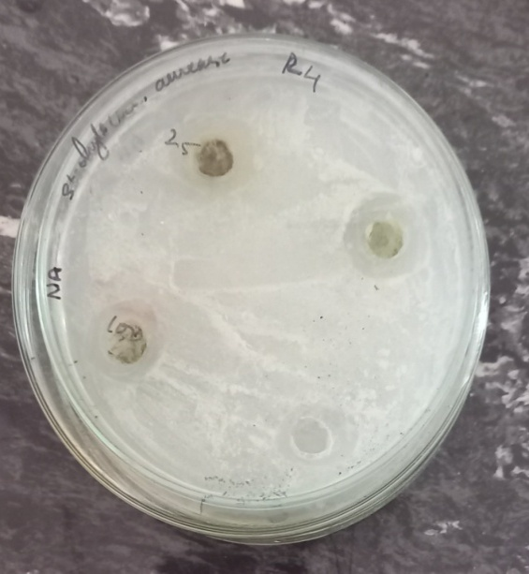
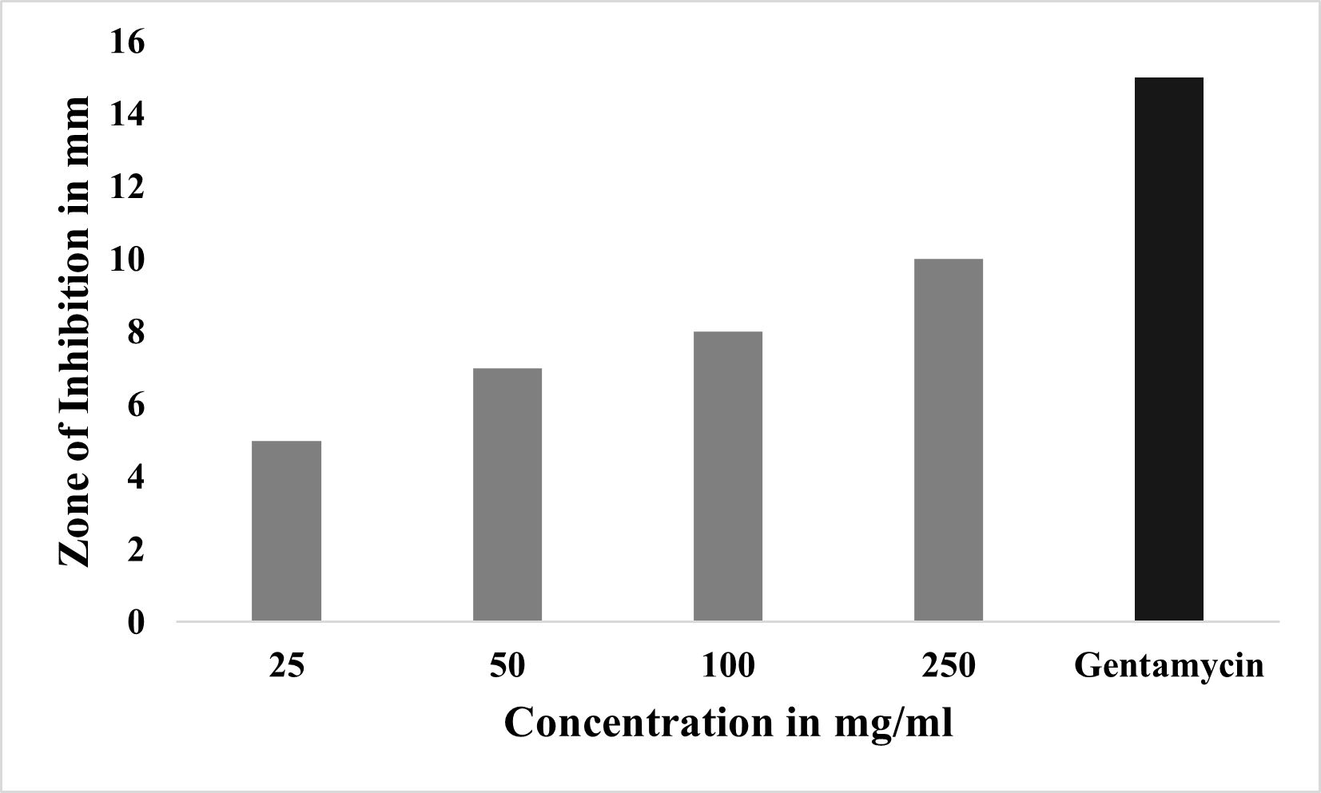
Cont.,
Table.2. Antibacterial activity of C. quandrangularis extract against Staphylococcus aureus.
Sl. No | Concentration (10mg/ml of DMSO) | Zone of Inhibition in mm
1. | 25 | 5
2. | 50 | 7
3. | 100 | 8
4. | 250 | 10
5. | Gentamycin | 15
A
B
Fig.2.Antibacterial activity of C. quandrangularis extract against Staphylococcus aureus.
The C. quandrangularis extract shows a potent antibacterial activity against Staphylococcus aureus by inhibiting their growth with increase in the concentration and gentamycin is used as a positive control. (A) Antibacterial activity assay by agar well diffusion method. (B) Graphical representation of antibacterial activity.

Slide 11
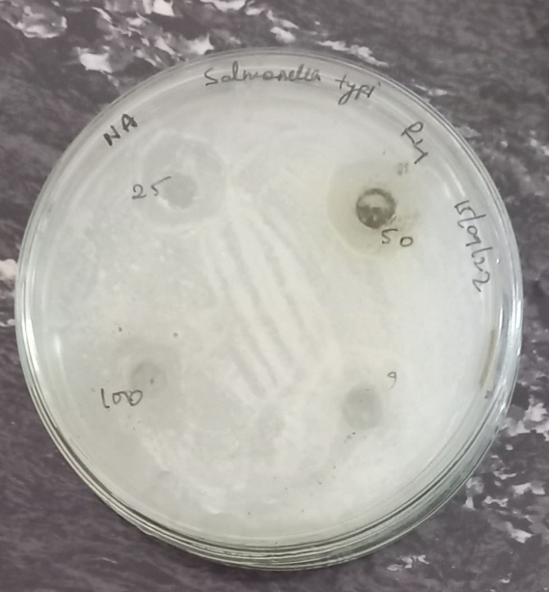
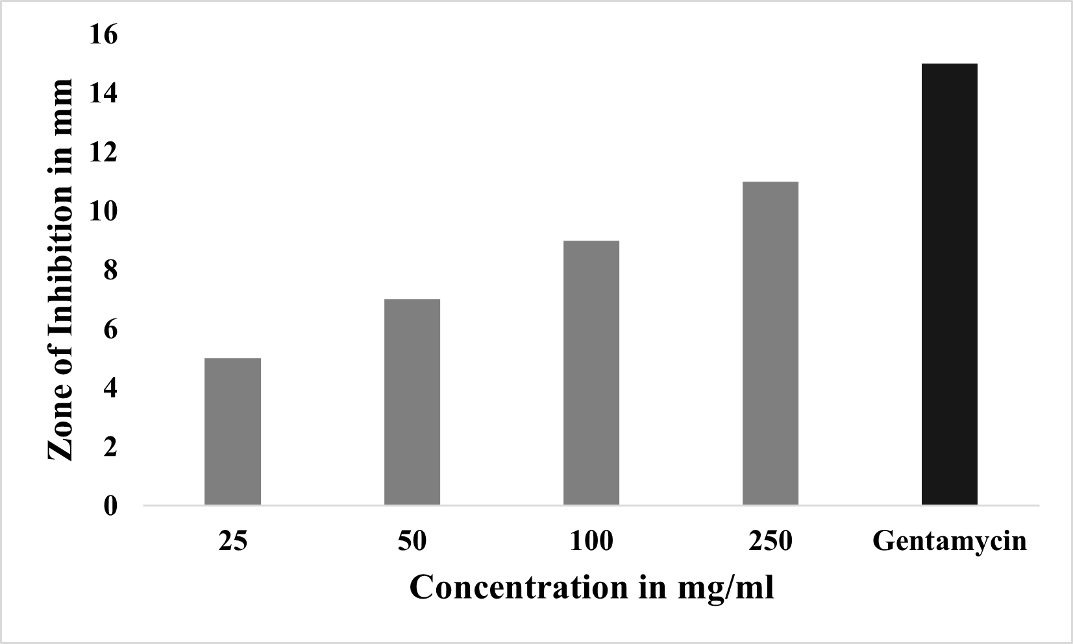
H
Cont.,
Table.2. Antibacterial activity of C. quandrangularis extract against Salmonella typhi. .
Sl. No | Concentration (10mg/ml of DMSO) | Zone of Inhibition in mm
1. | 25 | 5
2. | 50 | 7
3. | 100 | 9
4. | 250 | 11
5. | Gentamycin | 15
A
B
Fig.2. Antibacterial activity of C. quandrangularis extract against Salmonella typhi.
The C. quandrangularis extract shows a potent antibacterial activity against Salmonella typhi by inhibiting their growth with increase in the concentration and gentamycin is used as a positive control. (A) Antibacterial activity assay by agar well diffusion method. (B) Graphical representation of antibacterial activity.

Slide 12
Conclusion
Cissus quadrangularis is an indigenous medicinal plant of India and distributed throughout the tropical region in the world. It is known to be an ancient medicinal plant, with optimal healing in white tissue area of the body.
In this study, the qualitative phytochemical and anti-bacterial properties of C.quadrangularis were evaluated.
The qualitative phytochemical screening was evaluated by using ethanol extracts, and anti-bacterial activity of C.quadrangularis was studied against two pathogenic bacteria viz., S. aureus and S. typhi.
The secondary metabolites such as alkaloids, saponins, phenols, tannins, terpenoids and flavonoids were present in ethanolic extract of C.quadrangularis.
The antibacterial activity may be due to the presence of one or more chemical constituents present in the extract. The results claim that C. quadrangularis stem can be considered as a potential candidate for the development of novel antibacterial herbal formulation.

Slide 13
Reference
Garima Mishra , Saurabh Srivastava , B.P.Nagori (2016) Pharmacological and Therapeutic Activity of Cissus quadrangularis International Journal of PharmTech Research CODEN (USA). IJPRIF ISSN : 0974-4304 Vol.2, No.2, pp 1298-1310,
Piyush S.BafnaaPayal H.PatilaSaurabh K.MarubRakesh E.Mutha(2021) Cissus quadrangularis L: A comprehensive multidisciplinary review Journal of Ethnopharmacology Volume 279,, 114355.
K.N. Chidambara Murthy A. Vanitha M. Mahadeva Swamy, and G.A. Ravishankar (2004) Antioxidant and Antimicrobial Activity of Cissus quadrangularis L. Journal of Medicinal FoodVol. 6, No. 2.
Sidney J. Stohs,Sidhartha D. Ray(2012) A Review and Evaluation of the Efficacy and Safety of Cissus quadrangularis Extracts phytotherapy research Volume27, Pp 1107-1114.
Geetu singh, preeti rawat, rakesh mourya (2007) Constituents of Cissus quadrangularis Natural Product Research Formerly Natural Product Lettersn Volume 21, Pages 522-528.
Jhang H, Shen Y, Ruse ND, Haapasalo M. Antibacterial activity of endodontic sealers by modified direct contact test against Enterococcus faecalis. J Endod. 2009 Jul;35(7):1051-5. doi: 10.1016/j.joen.2009.04.022. PMID: 19567333.

Slide 14


